Slide 1
Git Introduction
Kamil Ritz; 23.02.2021

Slide 2
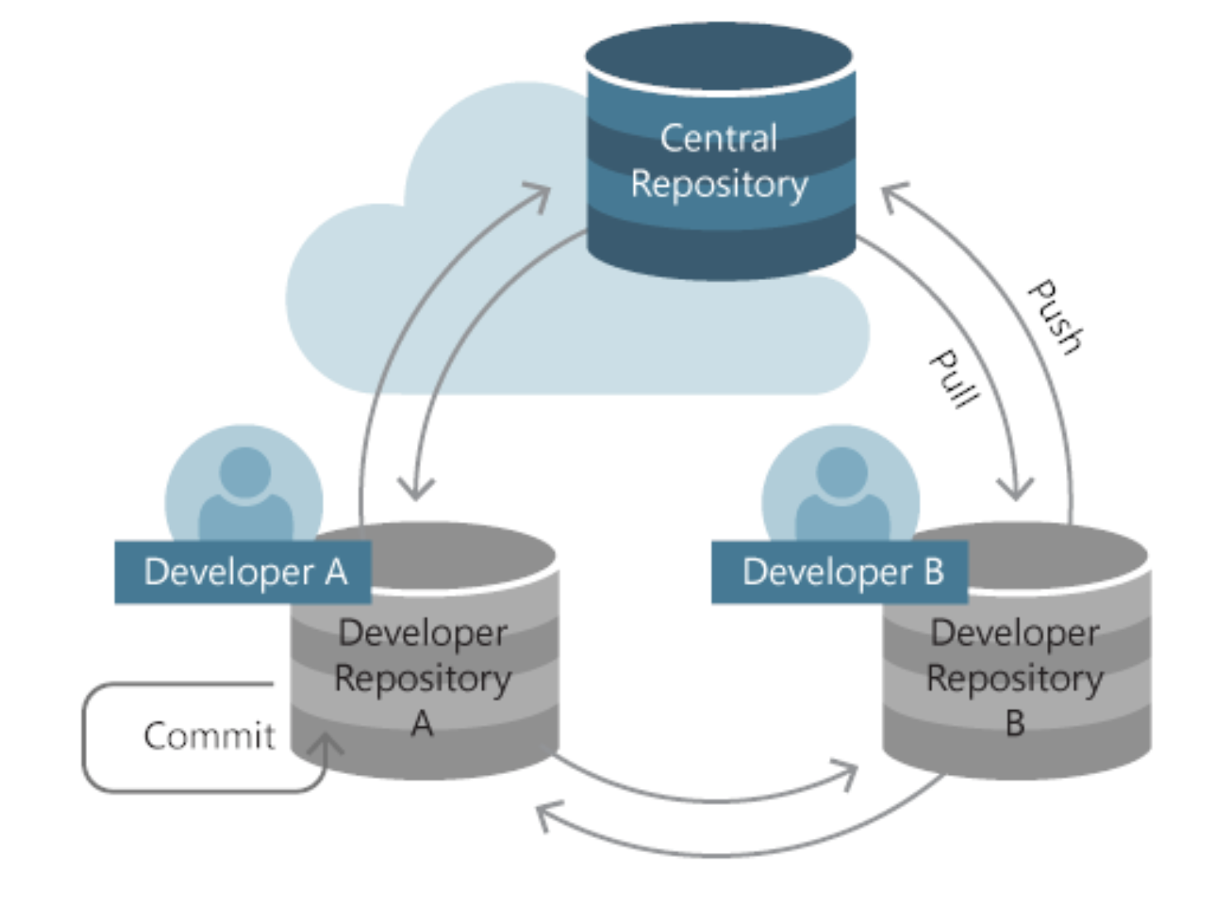
Why git?
Github/Gitlab
Working together on the same code without disaster
Version control: See changes over time. Being able to go back to previous state easily. (Not: Filename_V1, Filename_V2, … )
Standard method in industry.
Use for text-based file formats (.cs, .tex, .csv, …), but also for binary files (.excl, .docx, ….) helpful.

Slide 3
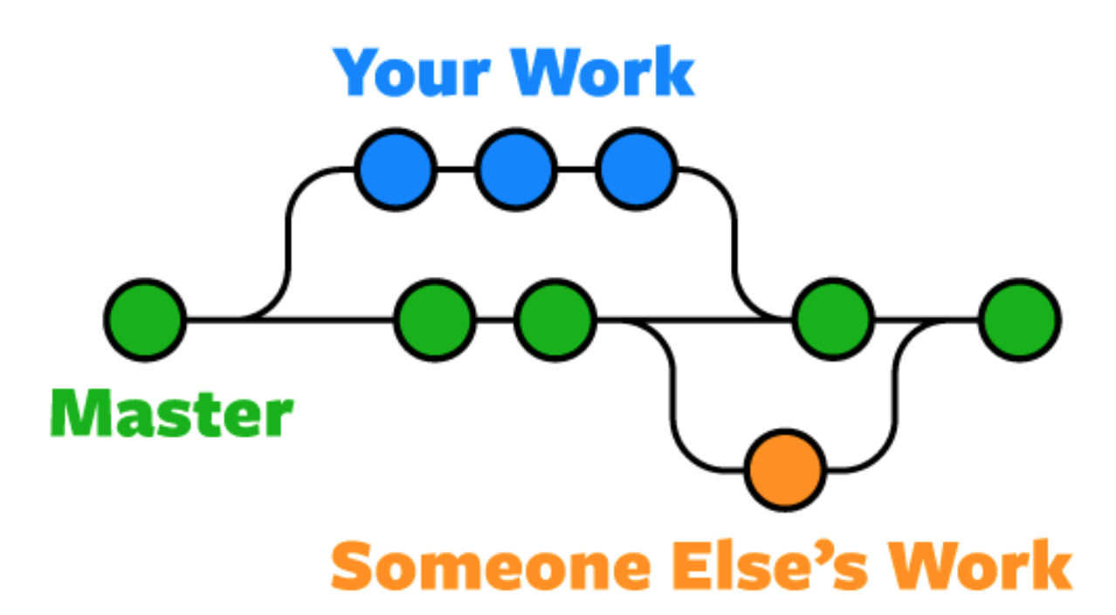
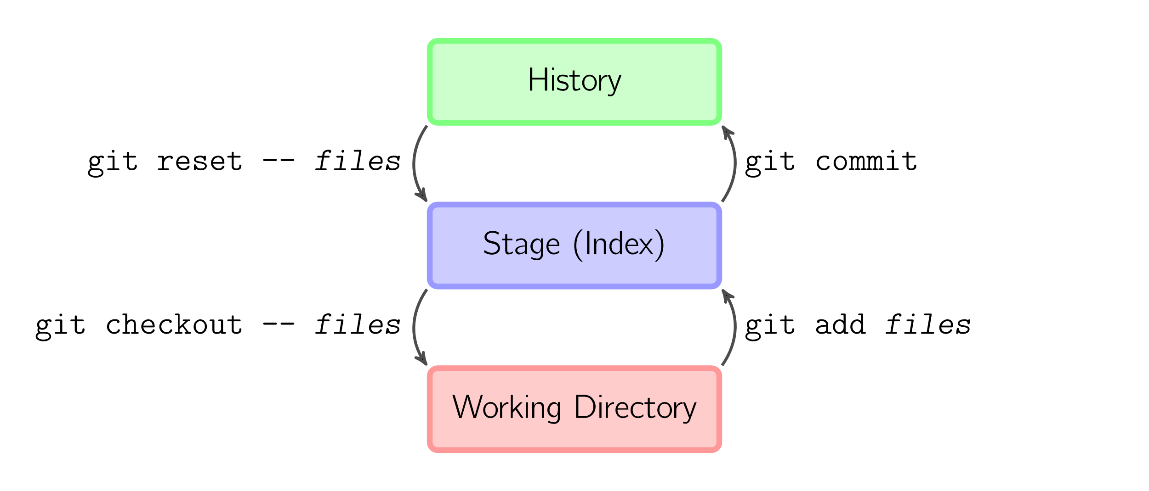
What is git?
Save state of repository in commits. Create branches and merge them.
Controlled by terminal commands. (Or different GUIs, best start with terminal)

Slide 4
Demo

Slide 5
Have a Gitlab account
ETH is providing a Gitlab account to you. Sign in with your nethz login: https://gitlab.ethz.ch/users/sign_in

Slide 6
Install Git
Windows: https://gitforwindows.org
Once installed,
Each commit has an author. Provide your name and mail address.
Open terminal:
git config --global user.name "YOUR_USERNAME"
git config --global user.email "your_mail_address "

Slide 7
Create ssh key and add it to Gitlab account
With SSH keys, you can connect to GitHub/GitLab without supplying your username or password at each visit
Create ssh key: https://gitlab.ethz.ch/users/sign_in (Use GitHub)
Add it to Gitlab account: https://docs.gitlab.com/ee/ssh/#add-an-ssh-key-to-your-gitlab-account

Slide 8
Other tutorials / further references
Decent introduction:
https://www.freecodecamp.org/news/learn-the-basics-of-git-in-under-10-minutes-da548267cc91/ (start from step 2)
Commiting only part of current changes : git add –p https://gist.github.com/mattlewissf/9958704
Cheatsheet with most common commands: https://about.gitlab.com/images/press/git-cheat-sheet.pdf

Slide 9
Good practices
Commit small pieces!
Name each commit reasonably, so that it is descriptive.
Push your changes from time to time to the remote repo on a branch with the same name. Creating a backup was never easier. Especially create such a remote backup before performing local git commands that you are not familiar with.

